Slide 1
Secure DATA HIDING in Image using STEGANOGRAPHy
CAPSTONE PROJECT
Presented By: Pallab karmakar.
Student Name : Pallab karmakar.
College Name & Department : College name - Durgapur institute of advanced technology and management.
Department- Chemical engineering.

Slide 2
OUTLINE
Problem Statement
Technology used
Wow factor
End users
Result
Conclusion
Git-hub Link
Future scope

Slide 3
Problem Statement
With rise in digital communication, data security and data privacy have become major concerns.
Traditional encryption methods make it obvious that data is being protected, attracting unwanted attention.
Steganography solves this by hiding secret messages inside images, making them invisible to unauthorized users.
This project implements image-based steganography to securely encode and retrieve hidden messages using a password.

Slide 4

Technology used
Programming language: Python
Libraries used:
Cv2 (OpenCV): For reading, modifying, and saving images.
Os: To handle file operations.
String: For character mapping during encryption and decryption.
3$)$ Platforms: Works on Windows, Linux, and macOS.

Slide 5
Wow factors
This project is special because of its unique features, which are:
Secure communication: Hides data inside images, making it invisible to unauthorized users.
Lightweight and fast: Uses simple pixel modification techniques, ensuring quick encryption and decryption.
Cross platform: Works on different operating systems.
Easily scalable: Can be extended to support audio, video, or even real-time steganography in future versions.

Slide 6
End users
Potential users of this project include:
Cyber security experts: For secure information transfer.
Journalists and Activists: To protect sensitive data from unauthorized access.
Government and military: To secure communication of classified data.
General users: To hide personal information like passwords inside images.

Slide 7
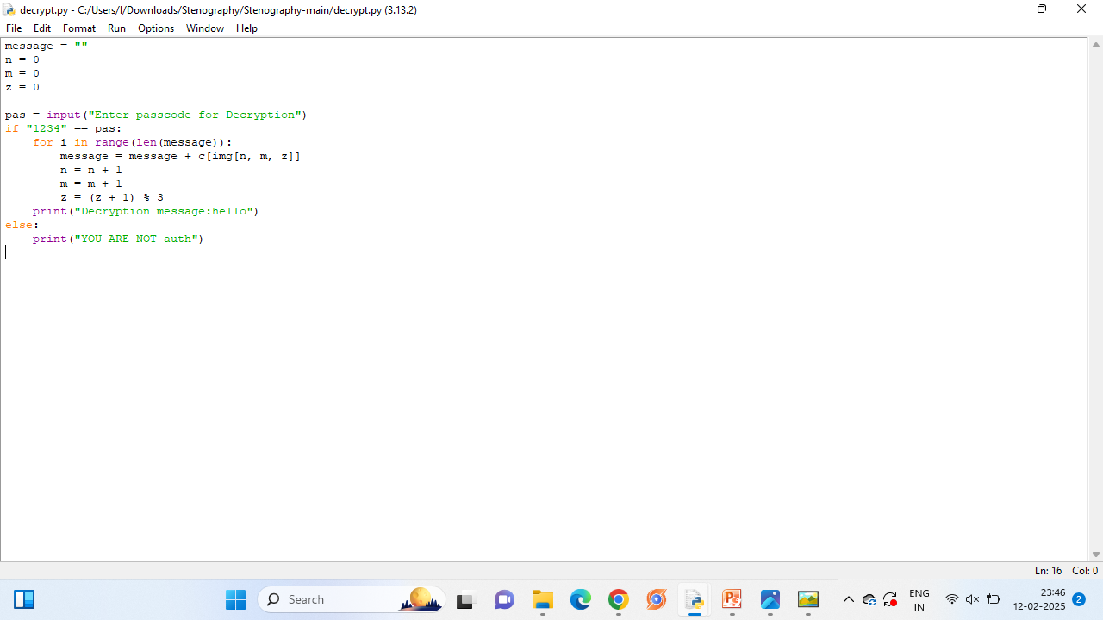
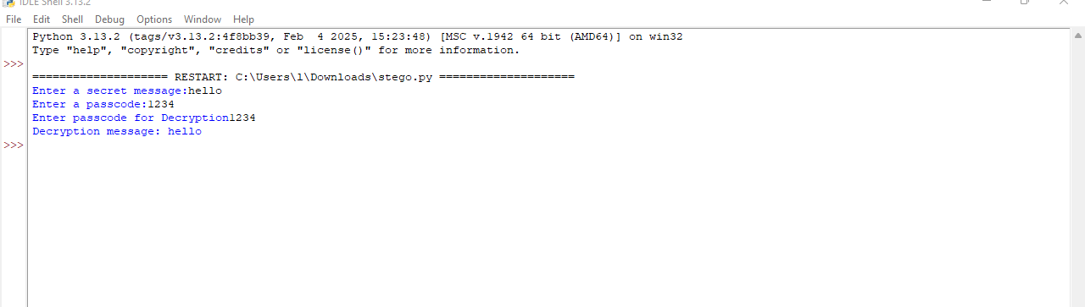
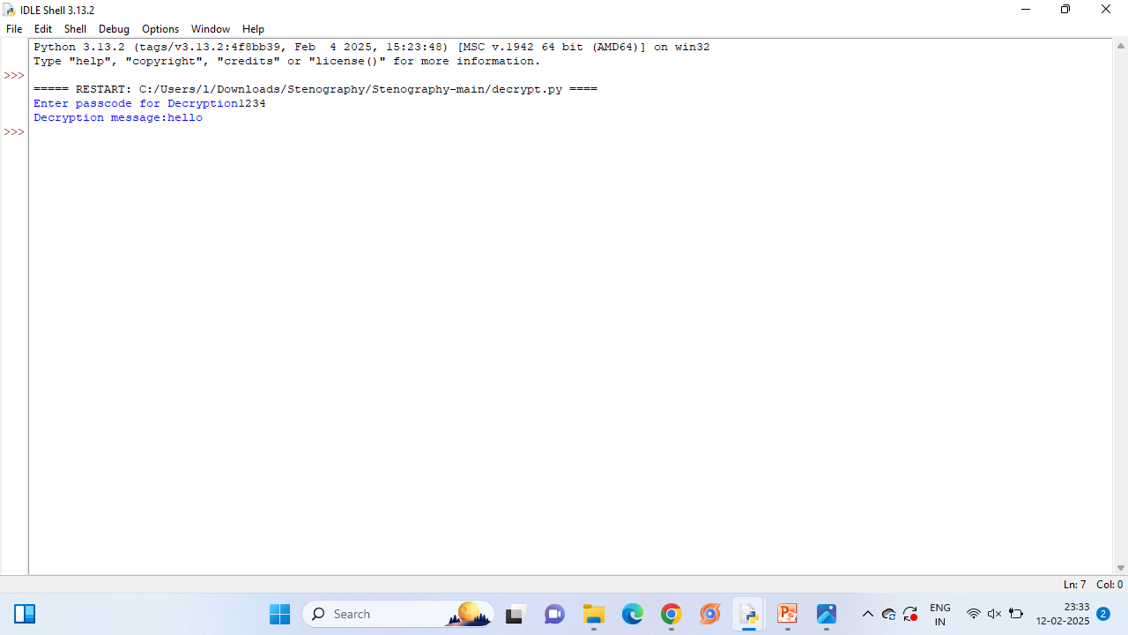
Results

Slide 8
Conclusion
The project solves the problem of secure data transmission by hiding text messages inside images using steganography. Unlike traditional encryption, this method ensures that the presence of hidden data is not obvious to outsiders. The project successfully demonstrates how data can be hidden, transmitted, and retrieved securely, making it a valuable tool for information security.

Slide 9
GitHub Link
https://github.com/pallabkarma/stego-data.git

Slide 10
Future scope(optional)
The future scope of this project is:
Support for audio and video steganography: Hiding messages into video frames.
More secure encoding methods: Using LSB (Least Significant Bit ) algorithms for stronger encryption.
AI-powered steganography: Implementing machine learning for automatic and adaptive encoding.
Mobile app integration: Developing an Android/iOS version for on-the-go secure messaging.

Slide 11
THANK YOU

